Slide 1
Table
Pitched by:
Timothy van der Steenhoven
Team:
Saskia van der Velden & Emmanuel Bakare

Slide 2
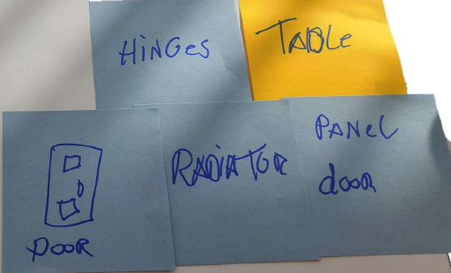
Materials

Slide 3

What is the new function?

Slide 4
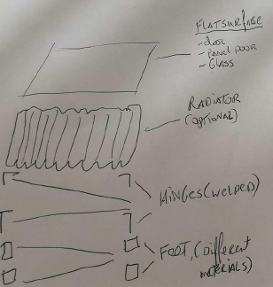
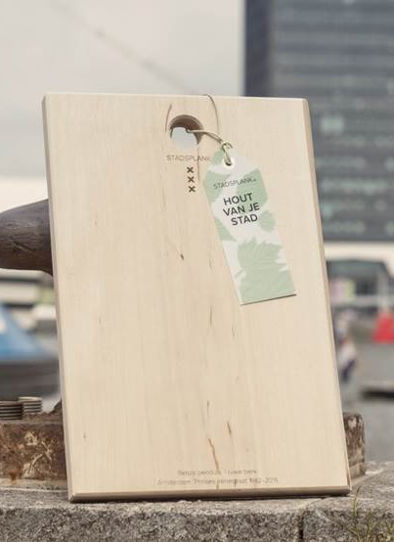
Why is this useful?
Surface
Glass
Panel door
Wooden door
Radiator (optional)
Feet
Welded Hinges
Wooden feet
€35,-
Versatility in production

Slide 5
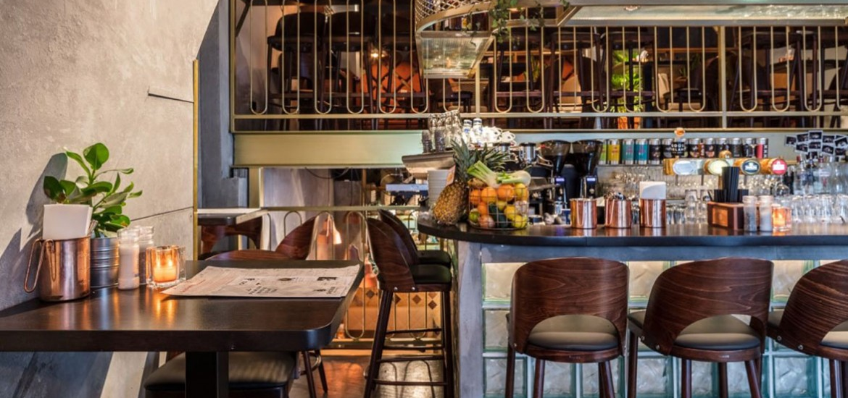
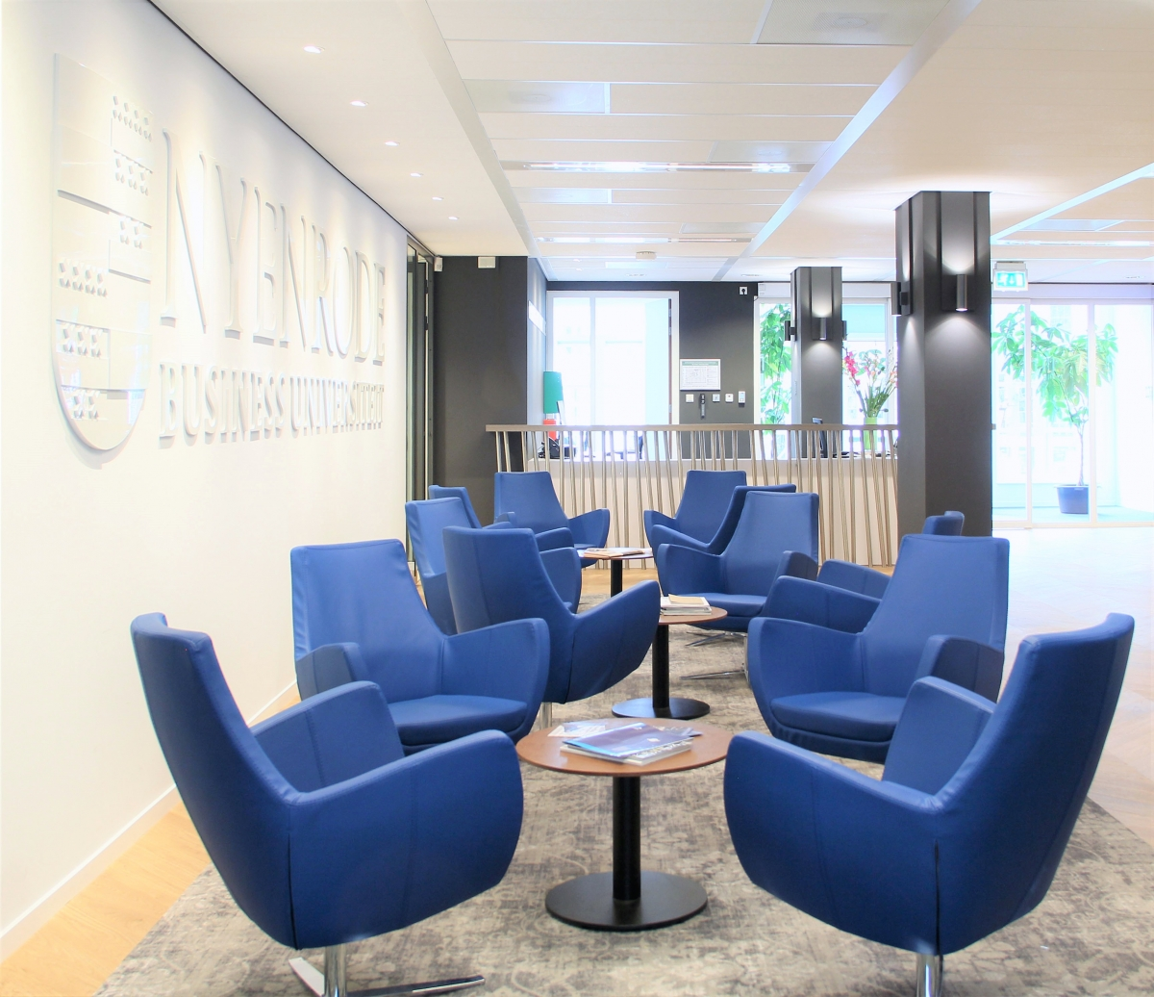
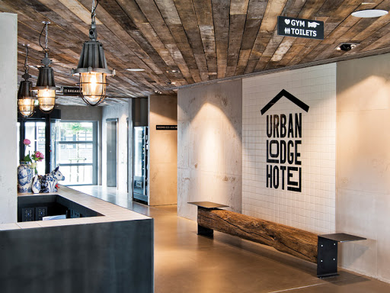
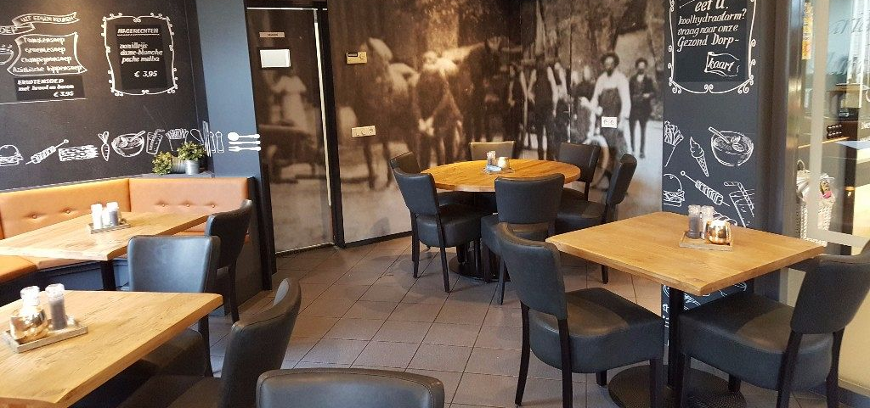
Where will this be applied?
Industrial look → Cafetaria’s
Notes:
Bars, hotels, cafeteria’s, schools/businesses in Amsterdam

Slide 6
Who will buy it?
Businesses in Amsterdam
Home owners in Amsterdam
Industrial
Ajax fans

Slide 7
Who could make this?
Recycled materials
Furniture
Culture

